Slide 1
“Description and comparison of recent discoveries and inventions.”

Slide 2
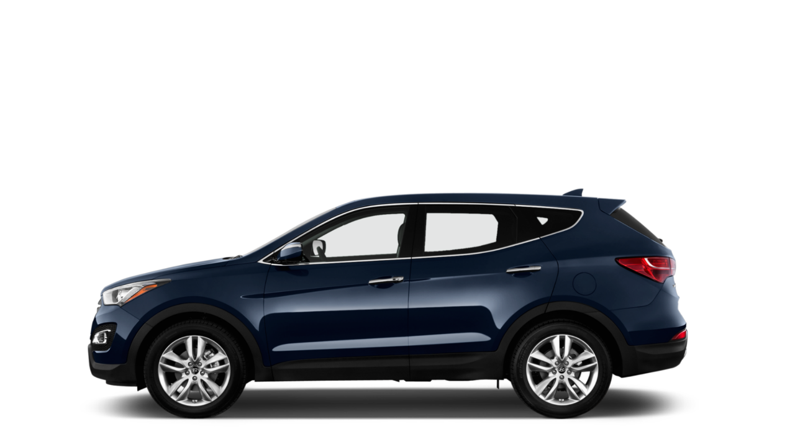
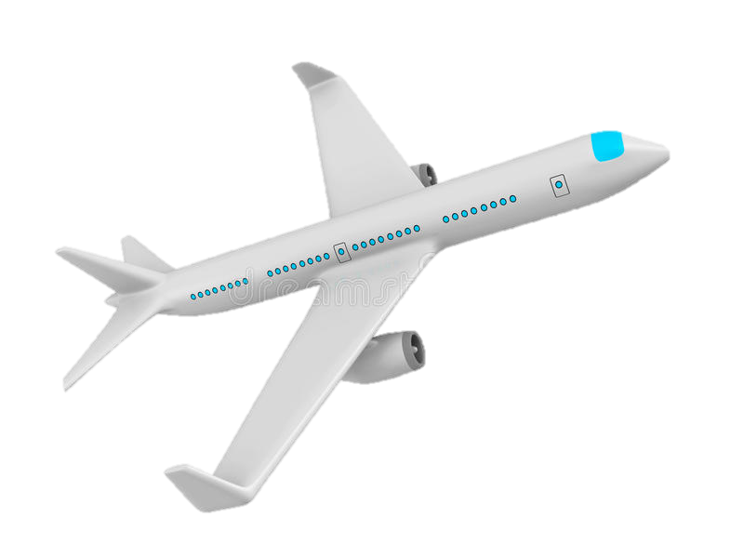
Discoveries and Inventions

Slide 3
Discoveries
A discovery is a thing which is discovered by someone which is already existing in nature.

Slide 4
Inventions
An invention is a new thing invented by a person.

Slide 5
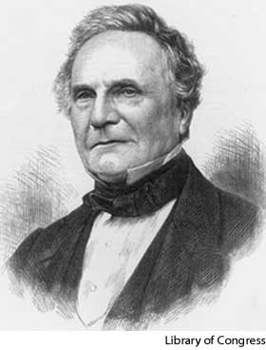
The computer
Invented by Charles Babbage
In the year of 1822
It was made in Cambridge ,England
Invention

Slide 6
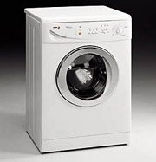
Electric washing machine
Invented by Alva J. Fisher
In 1908, in Chicago
Invention

Slide 7
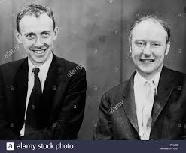
DNA
Discovreed by Watson & Crick
In 1953
Discovery

Slide 8
Do you know of any other discovery or invention?

