Slide 1
8th Grade
Content: Greetings
Listening N°1 Saludos y despedidas

Slide 2
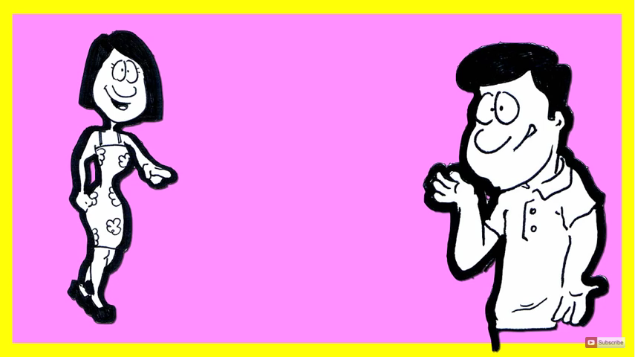
GREETINGS
Hello
Hi

Slide 3
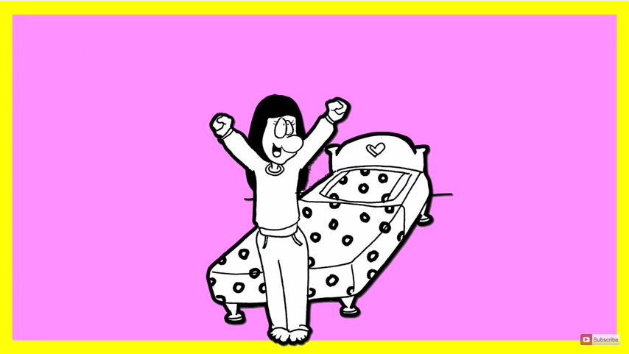
GREETINGS
Good morning!

Slide 4
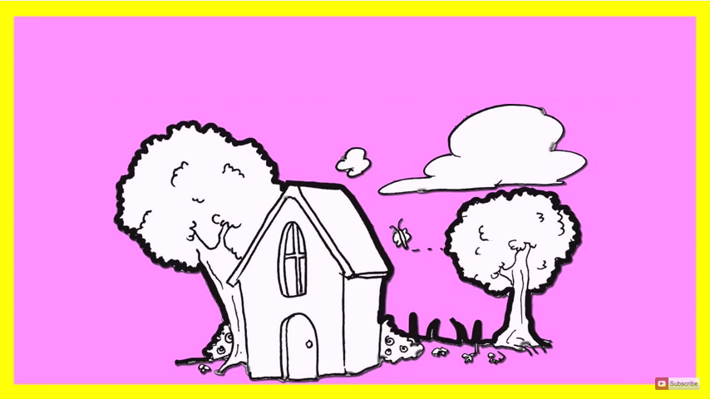
GREETINGS
Good afternoon!

Slide 5
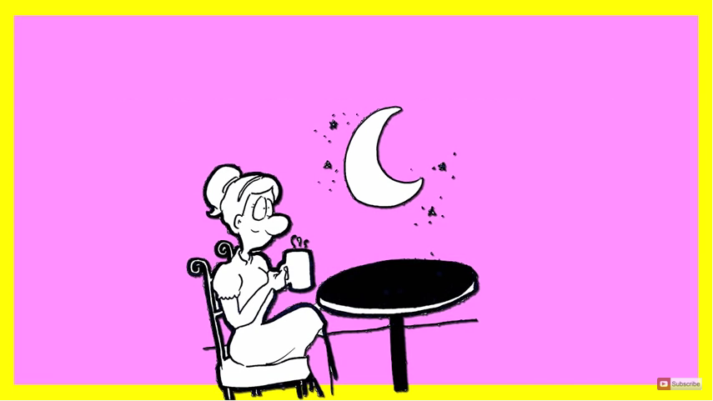
GREETINGS
Good evening!

Slide 6
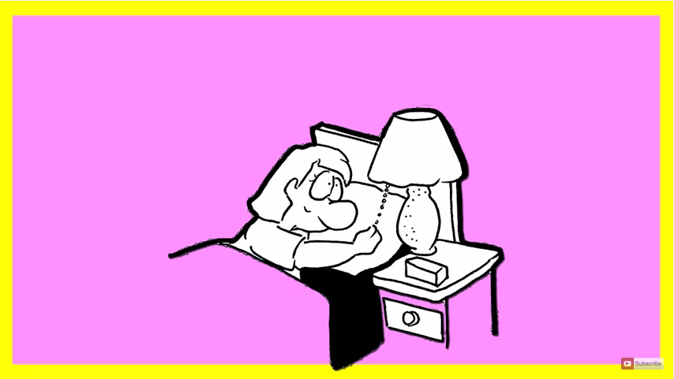
GREETINGS
Good night!

Slide 7
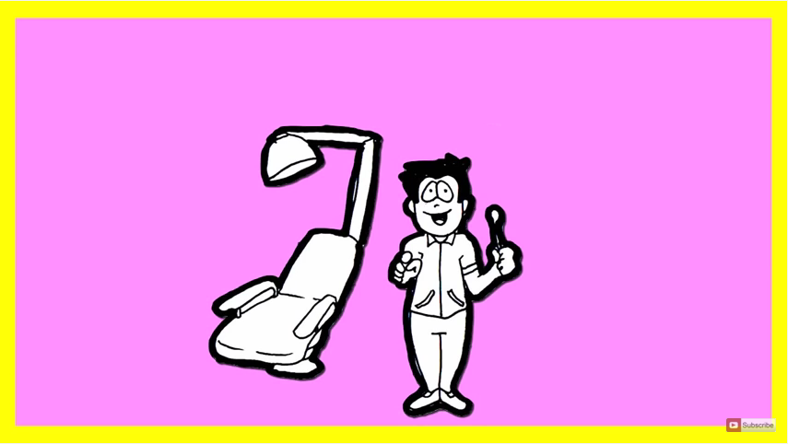
GREETINGS
How are you?

Slide 8
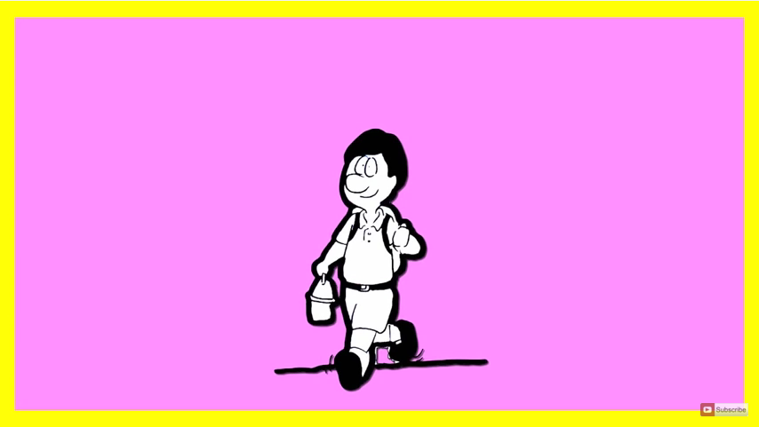
GREETINGS
I’m good!

Slide 9
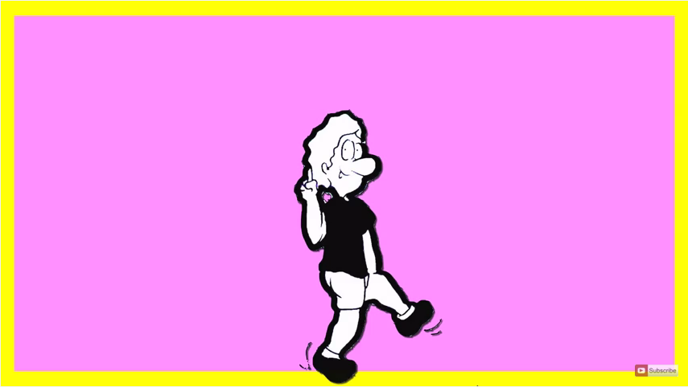
GREETINGS
I’m great!

Slide 10
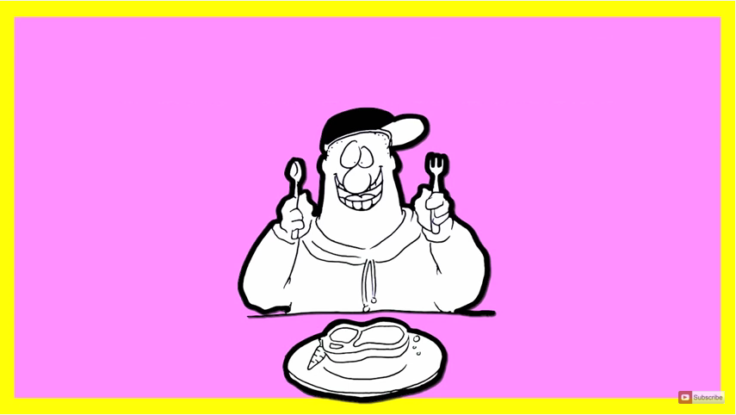
GREETINGS
I’m wonderful!

Slide 11
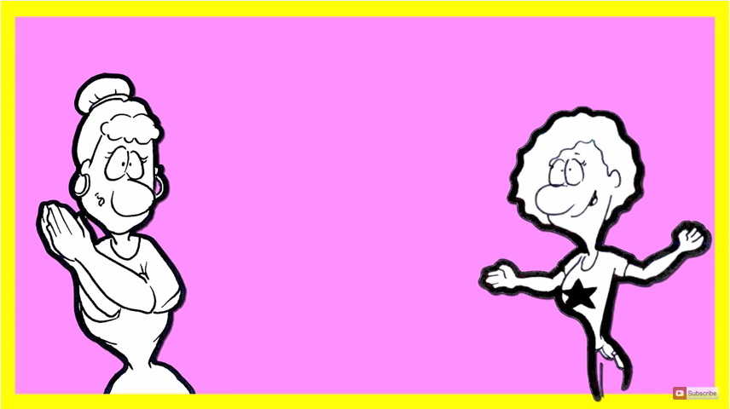
GREETINGS
Good bye!
Bye bye!

Slide 12
Crea un saludo en tu cuaderno luego practícalo con tu compañero de clases.

