Slide 1
Lámina de resumen 7th Grade

Slide 2
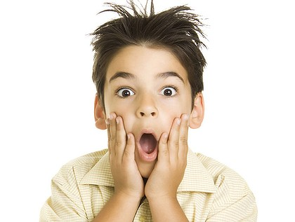
FEELINGS AND EMOTIONS
Surprised

Slide 3
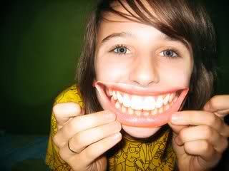
FEELINGS AND EMOTIONS
Happy

Slide 4
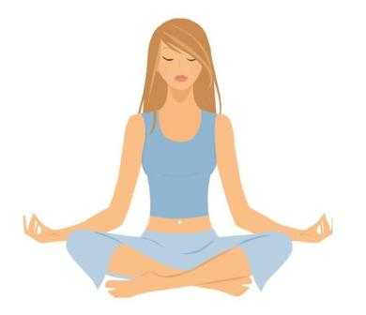
FEELINGS AND EMOTIONS
Peaceful

Slide 5
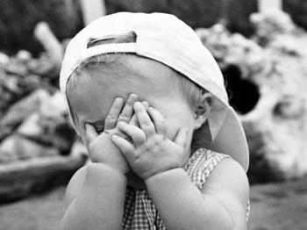
FEELINGS AND EMOTIONS
Shy

Slide 6
FEELINGS AND EMOTIONS
Excited

Slide 7
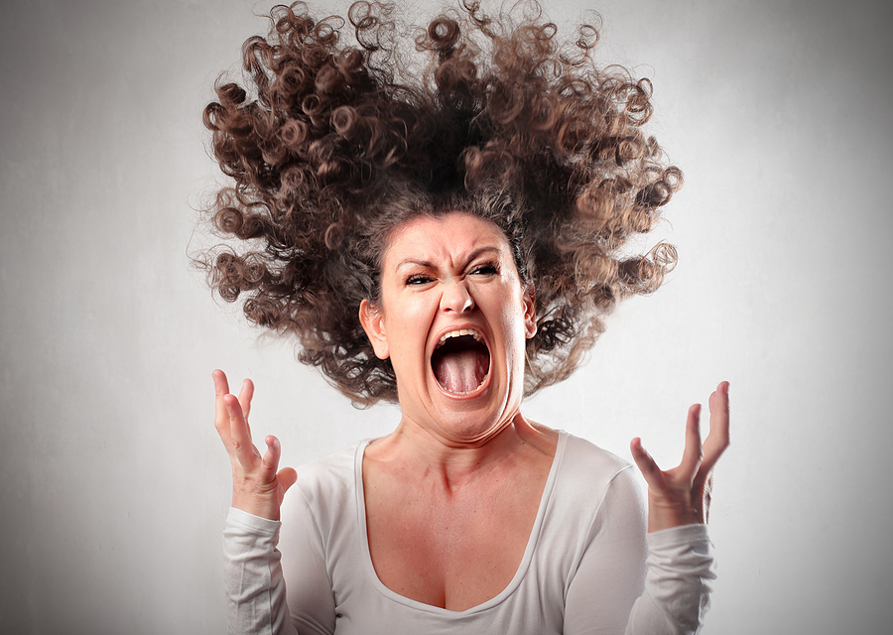
FEELINGS AND EMOTIONS
Angry

Slide 8
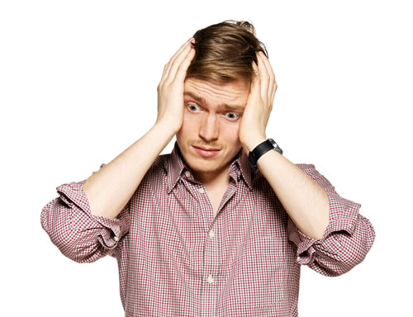
FEELINGS AND EMOTIONS
Worried

Slide 9
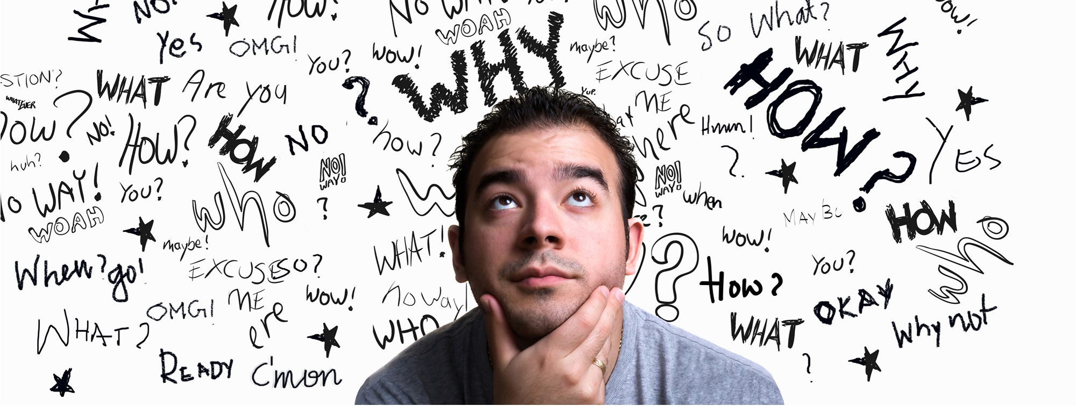
FEELINGS AND EMOTIONS
Thoughtful

Slide 10
FEELINGS AND EMOTIONS
Sorry

Slide 11
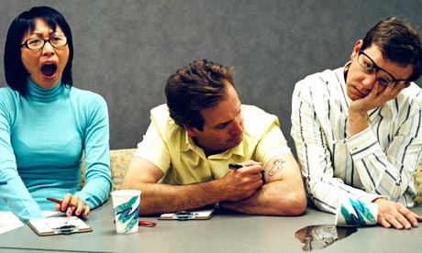
FEELINGS AND EMOTIONS
Bored

Slide 12
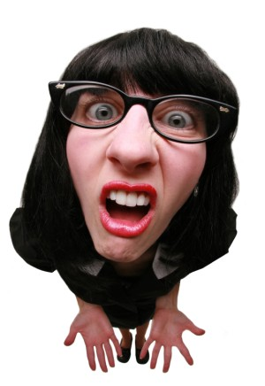
FEELINGS AND EMOTIONS
Confused

Slide 13
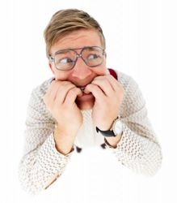
FEELINGS AND EMOTIONS
Nervous

Slide 14
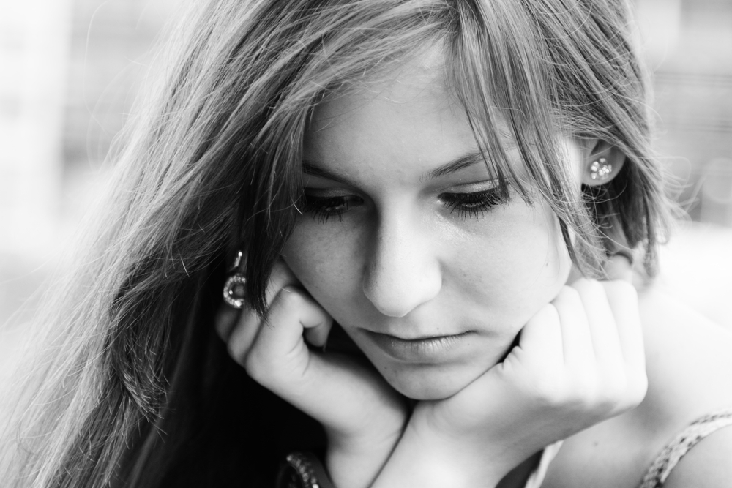
FEELINGS AND EMOTIONS
Sad

Slide 15
FEELINGS AND EMOTIONS
Confident

Slide 16
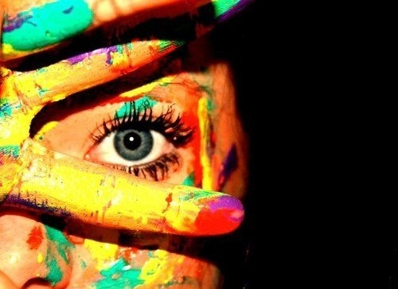
PERSONALITY ADJECTIVES
Creative

Slide 17
PERSONALITY ADJECTIVES
Generous

Slide 18
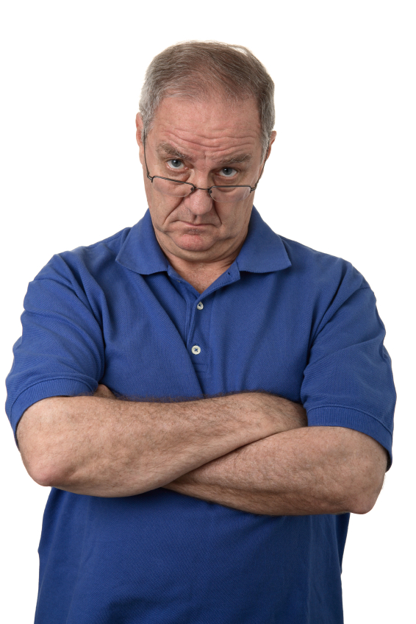
PERSONALITY ADJECTIVES
Serious

Slide 19
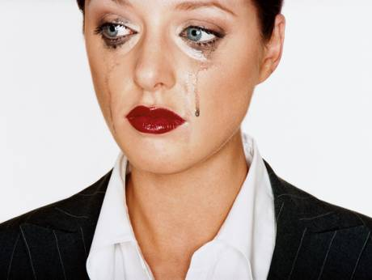
PERSONALITY ADJECTIVES
Sensitive

