Slide 1
Writing N°3 tema: Palabras de preguntas Objetivo: Identificar y aplicar las diferentes palabras de preguntas.

Slide 2
When?
a
Where?
Why?
How?
How?

Slide 3
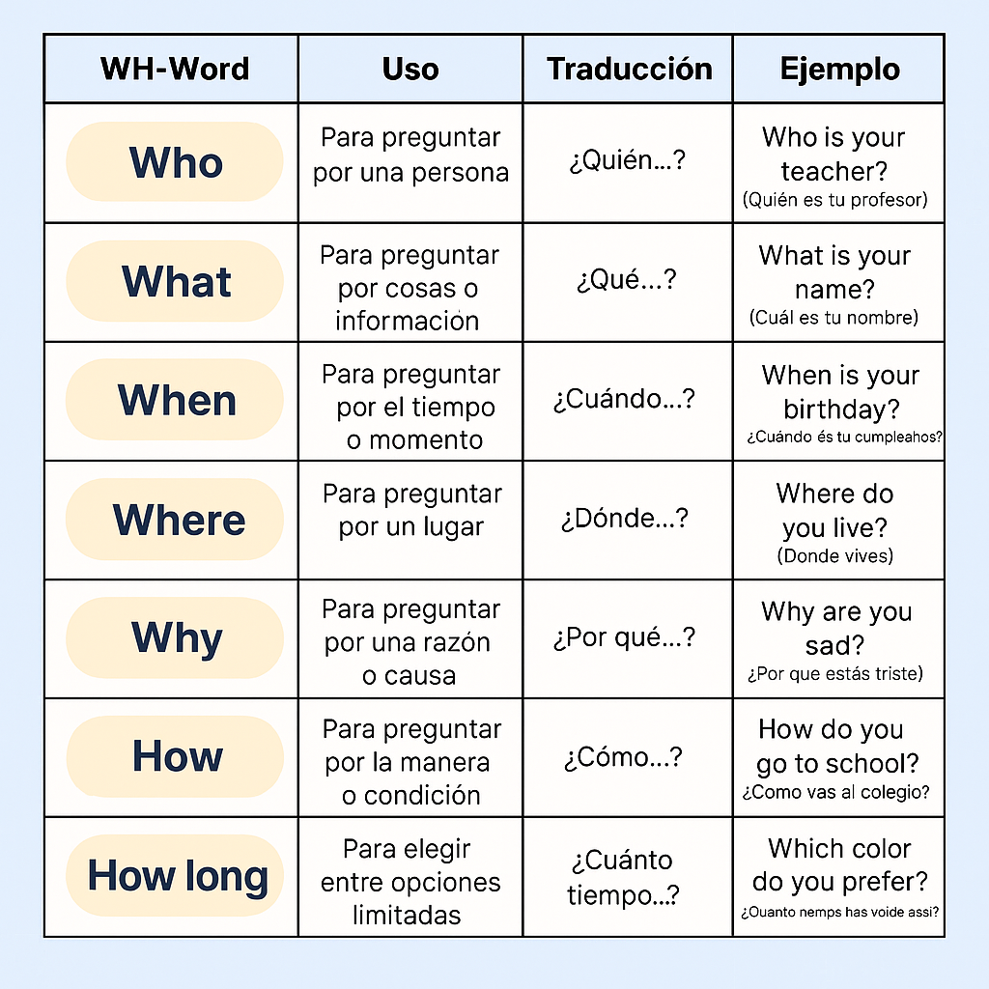

Slide 4
Now let’s practice!

Slide 5
Identify the Question Words in this email:
How
Hi Emma! How are you? I hope you’re ok.
I’m writing to tell you that I’m going to your town and I wish to see you. When are you going to be in your house? So I can check my schedule and we can go out and eat some pizza.
I would love to walk and see my old town again. Where is your house? I always forget the address, so I can be there as soon as possible.
And finally I would like to know, what do you prefer? A pink sweater or a blue shirt? I’m looking for some presents!
See you soon friend!
Kathy.
When
Where
what

Slide 6
Join the phrase with the correct question word:
…….is that?
This is an apple.
Where
……. are you?
I’m in my house.
What
……… is the first day of school?
In March.
How
………. are you?
I’m fine.
When

Slide 7
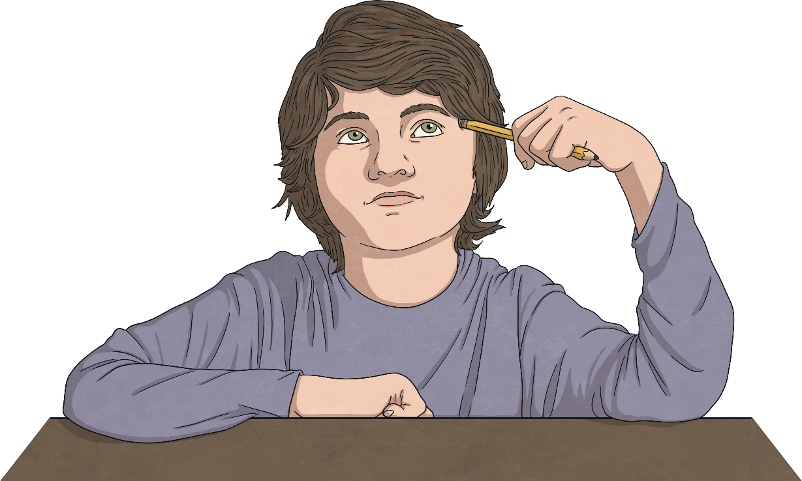
Name the question word
is your grandma? She is 86 years old.
is your house? My house is in Valparaíso.
fruit do you prefer? Apples or pears?
is this? This is a surprise.
is my birthday?
How old
Where
Which
What
When

Slide 8
Create two questions and ask a partner:
.
.
Share your questions and answers with the class!

Slide 9
Good Job!!!

